Slide 1
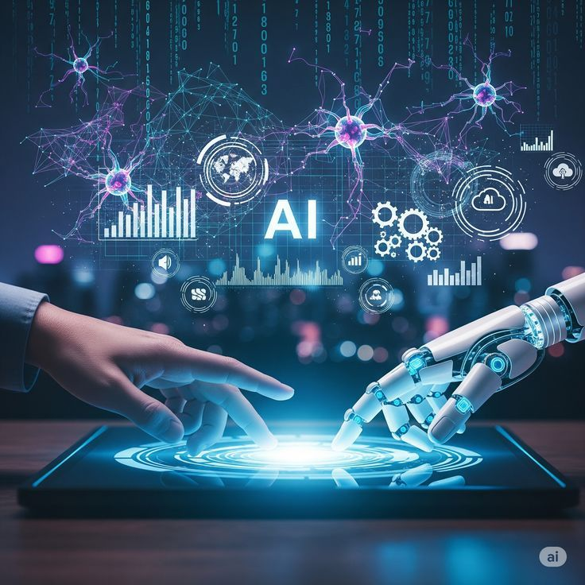
AI & Emerging Technologies
Artificial Intelligence
Shaping the Future of Technology
Presented by: ____________________
Department: Computer Science Engineering
Presented by: Anjali kumari ; Radhika rani
Branch: diploma (CSE)

Slide 2
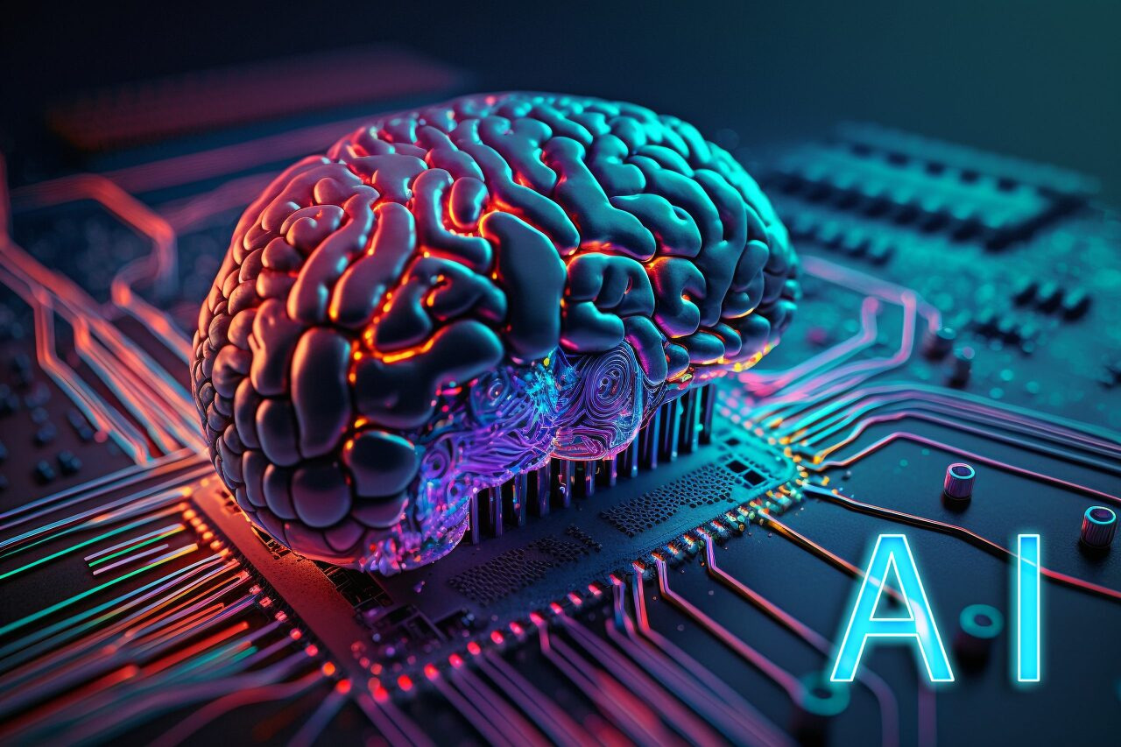
Presentation Overview
Introduction to Artificial Intelligence
How AI Works
Types of AI
AI in Daily Life
Applications of AI
Benefits of AI
Challenges and Ethical Concerns
Future of AI
Conclusion
Artificial Intelligence: Shaping the Future | 2

Slide 3
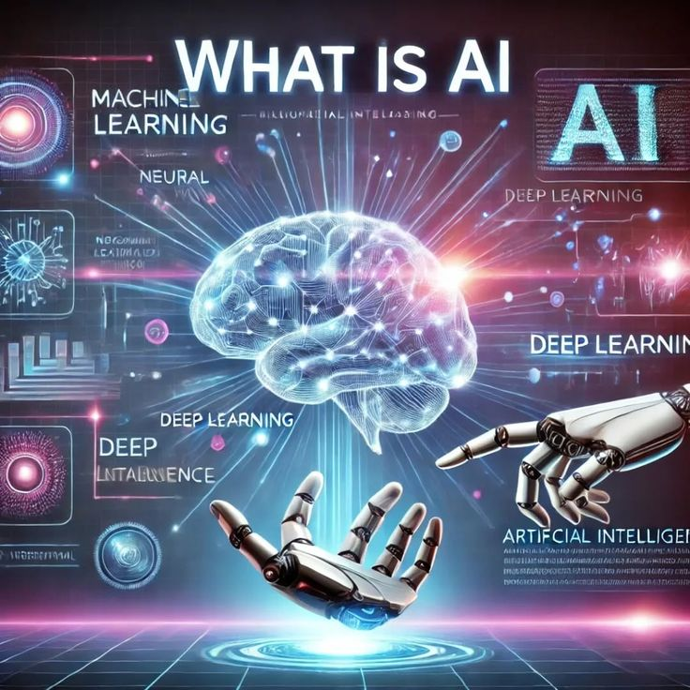
Introduction to Artificial Intelligence
Artificial Intelligence (AI) is a branch of computer science.
It enables machines to perform tasks that normally require human intelligence.
AI is becoming an important part of modern life.
It helps people solve problems, analyze information, and make decisions.
Artificial Intelligence: Shaping the Future | 3

Slide 4
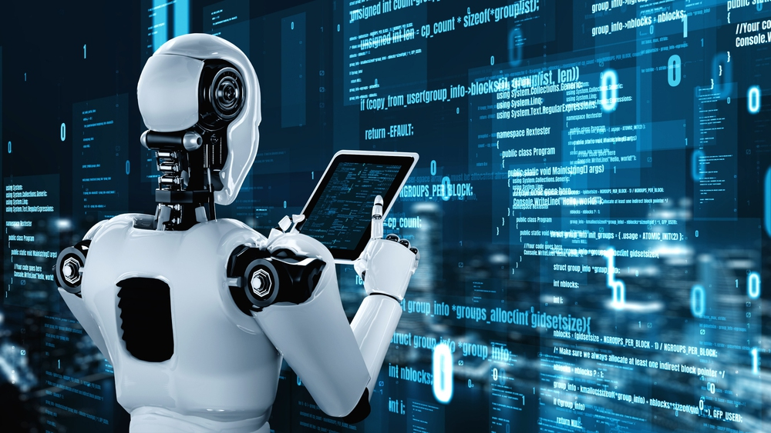
What Can AI Do?
Learn from data and experience
Recognize images, speech, and patterns
Understand and generate human language
Make predictions and recommendations
Automate repetitive tasks
Artificial Intelligence: Shaping the Future | 4

Slide 5
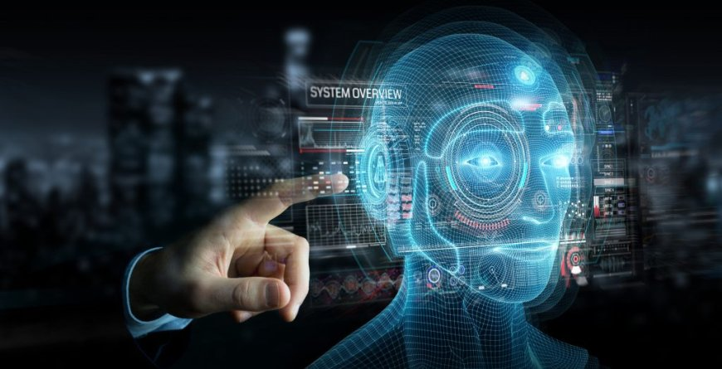
How Does AI Work?
Data: AI collects information from different sources.
Learning: Algorithms identify patterns in the data.
Decision-making: The system uses learned patterns to make predictions.
Output: AI provides a result, recommendation, or action.
Human supervision helps improve accuracy and fairness.
Artificial Intelligence: Shaping the Future | 5

Slide 6
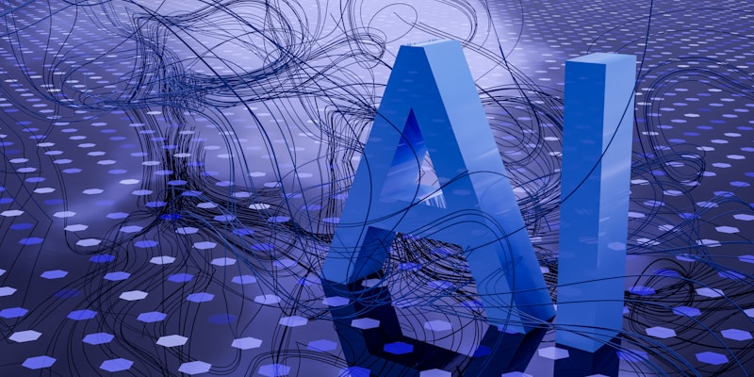
Types of Artificial Intelligence
Narrow AI: Designed to perform a specific task.
General AI: A theoretical form of AI with broad human-like abilities.
Super AI: A theoretical concept of intelligence beyond human abilities.
Most AI systems used today are examples of Narrow AI.
Artificial Intelligence: Shaping the Future | 6

Slide 7
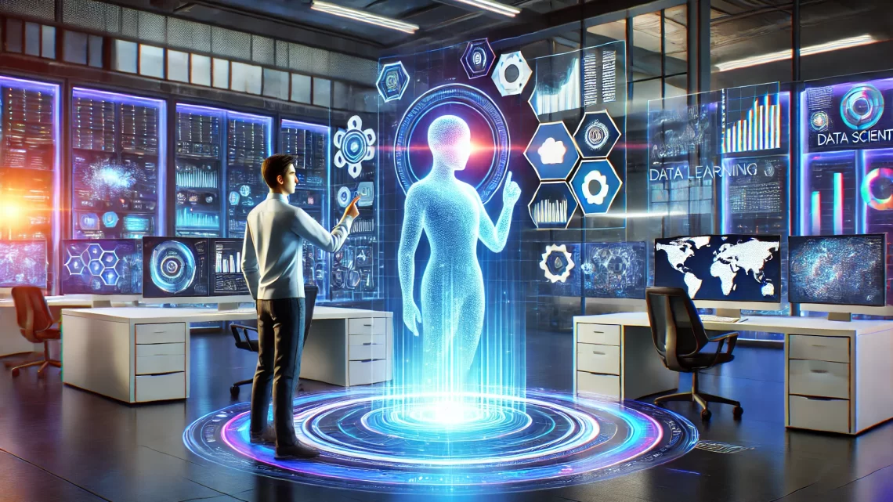
AI in Daily Life
Voice assistants such as Siri and Google Assistant
Recommendation systems on video and shopping platforms
Face recognition and smartphone features
Chatbots and online customer support
Navigation, spam filters, and smart search
Artificial Intelligence: Shaping the Future | 7

Slide 8
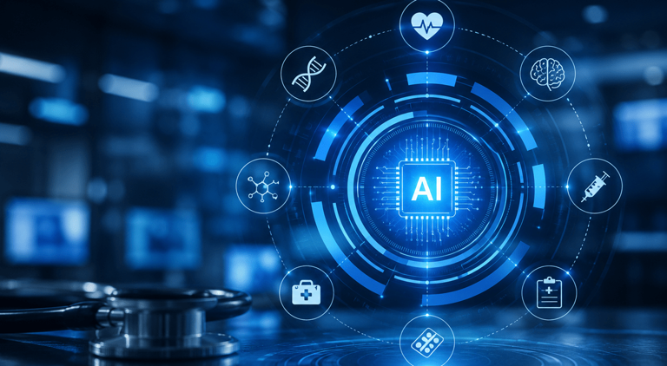
Applications of AI
Healthcare: Helps analyze medical information and support diagnosis.
Education: Supports personalized learning and study tools.
Agriculture: Helps monitor crops, soil, and weather conditions.
Transport: Supports traffic management and driver-assistance systems.
Business: Improves automation, customer service, and data analysis.
Artificial Intelligence: Shaping the Future | 8

Slide 9
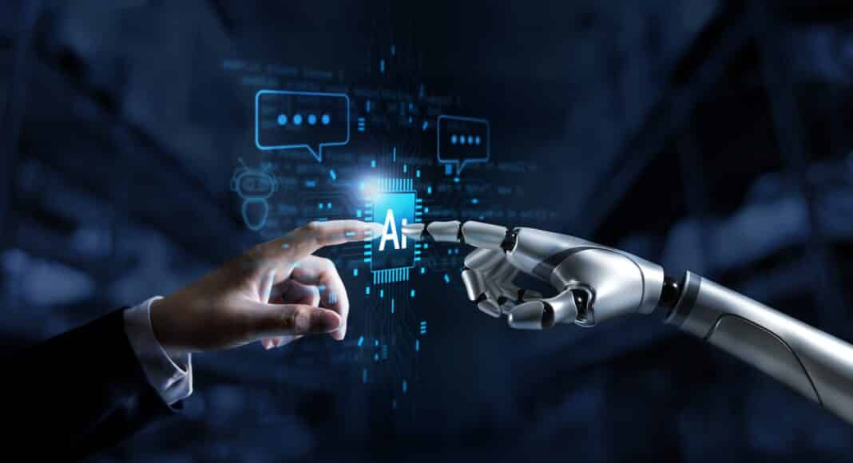
Benefits of AI
Saves time and improves efficiency
Reduces repetitive and manual work
Analyzes large amounts of data quickly
Supports better predictions and decisions
Can improve safety and productivity
Artificial Intelligence: Shaping the Future | 9

Slide 10
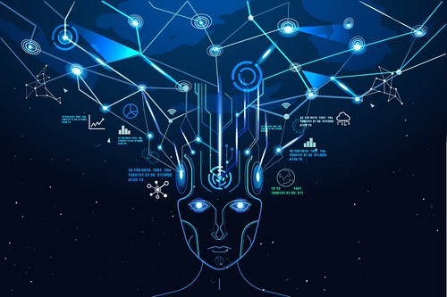
Challenges and Ethical Concerns
Privacy and protection of personal data
Incorrect, biased, or unfair results
Changes in jobs and required skills
Overdependence on technology
Need for transparency, human supervision, and responsible use
Artificial Intelligence: Shaping the Future | 10

Slide 11

Future of AI
Smarter and more useful digital assistants
Improved healthcare and scientific research
Personalized education and learning
Advanced robotics and smart cities
New career opportunities and new skills
Artificial Intelligence: Shaping the Future | 11

Slide 12
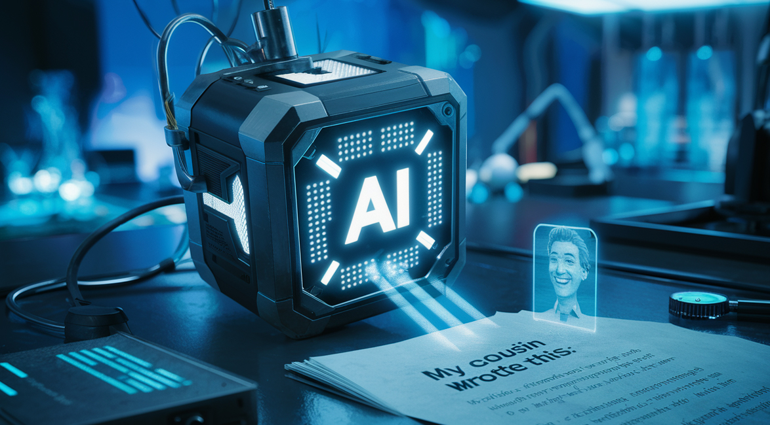
Conclusion
Artificial Intelligence is transforming the way we live and work.
It offers many benefits but also creates important challenges.
AI should be used safely, fairly, and responsibly.
Learning digital skills will help us prepare for the future.
AI can support human progress when guided by human values.
Artificial Intelligence: Shaping the Future | 12

Slide 13

Thank You
Any Questions?
Artificial Intelligence: Shaping the Future | 14

